Slide 1

Tech Stock Strategy
July 2023
Final Bootcamp Project
Álvaro Palmero

Slide 2
AGENDA
Project overview
Context and objectives
TECH STOCK ANALYSIS
Trends and exceptions
RECOMMENDATIONS
Key conclusions

Slide 3
PROJECT OVERVIEW
About the dataset *
Context
The datasets consist on daily stock prices and volume of six different tech companies: Amazon, Google, Alibaba, Tesla, Meta, Apple.
6
Tech companies
1
US Market
Objective
Analyse tech stock market during the selected years
Recommend the most suitable strategy/portfolio for our clients for entering into the tech stock market
2
Year stock prices (2021-2022)
* Source: credit_card_fraud_vf.csv

Slide 4
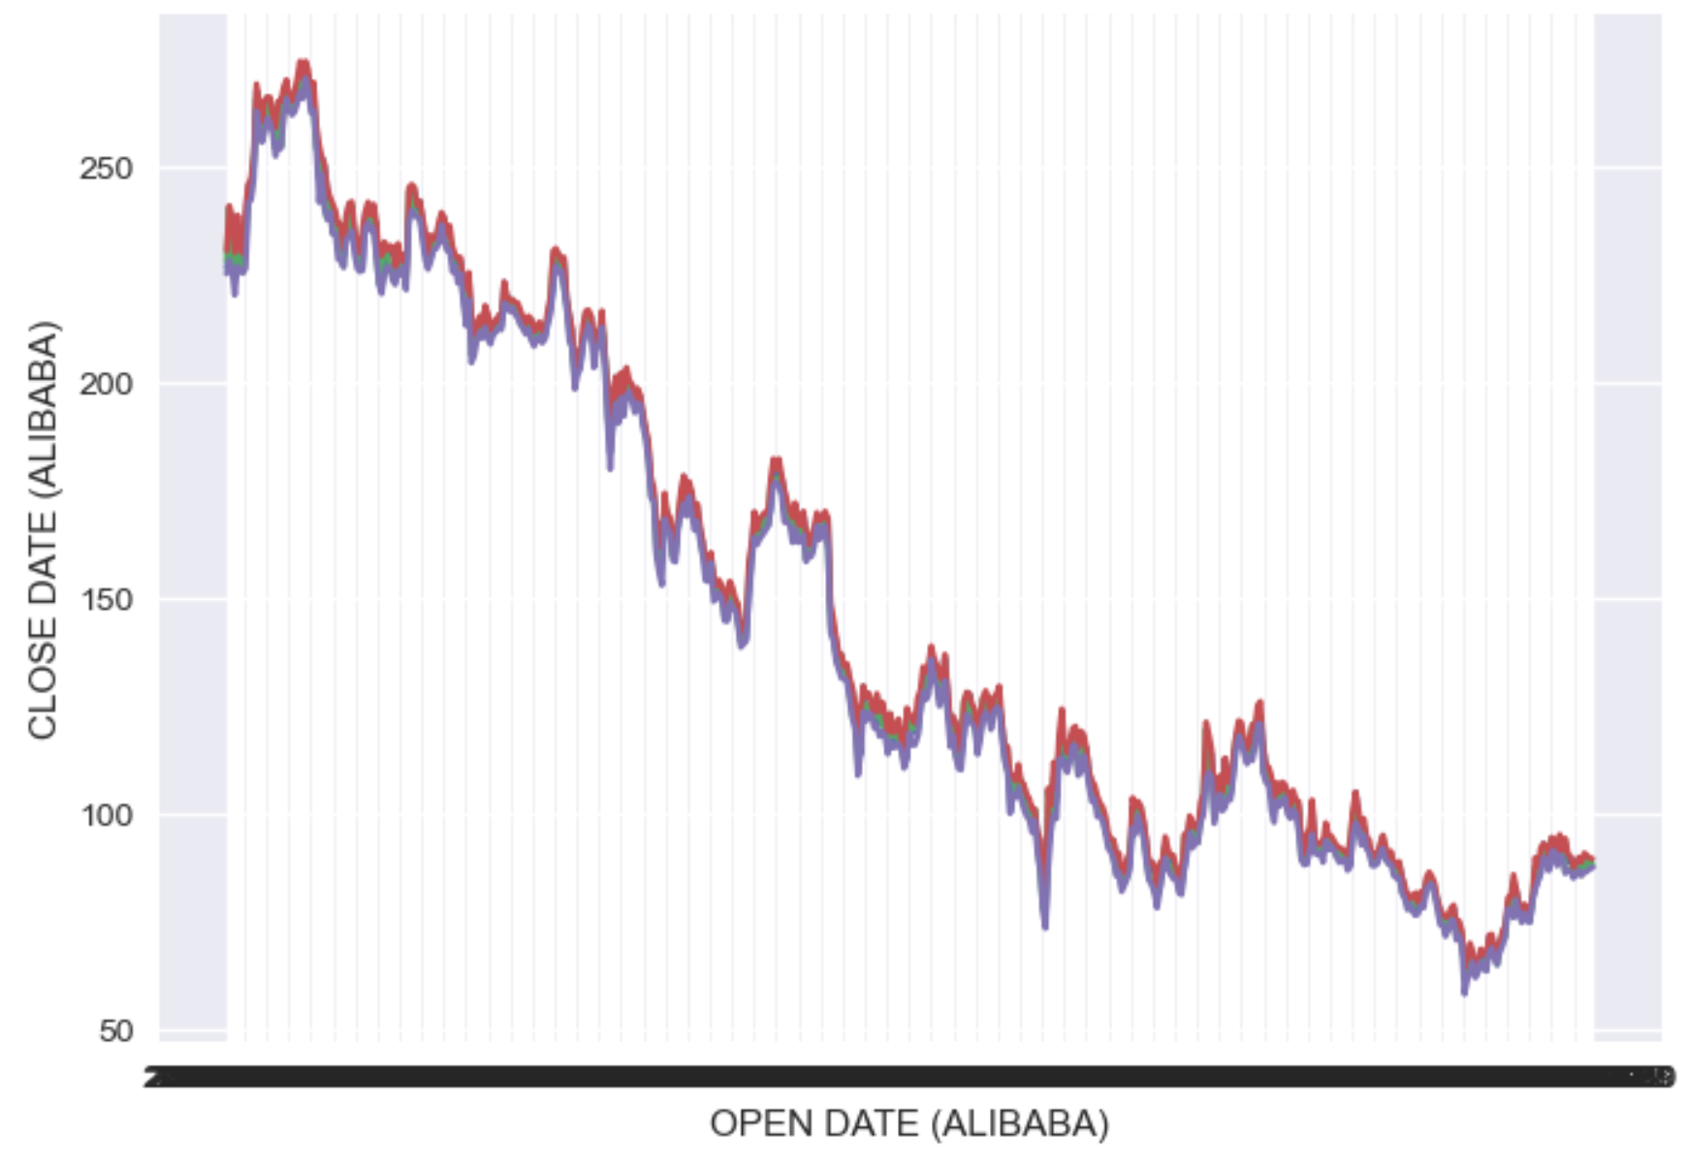
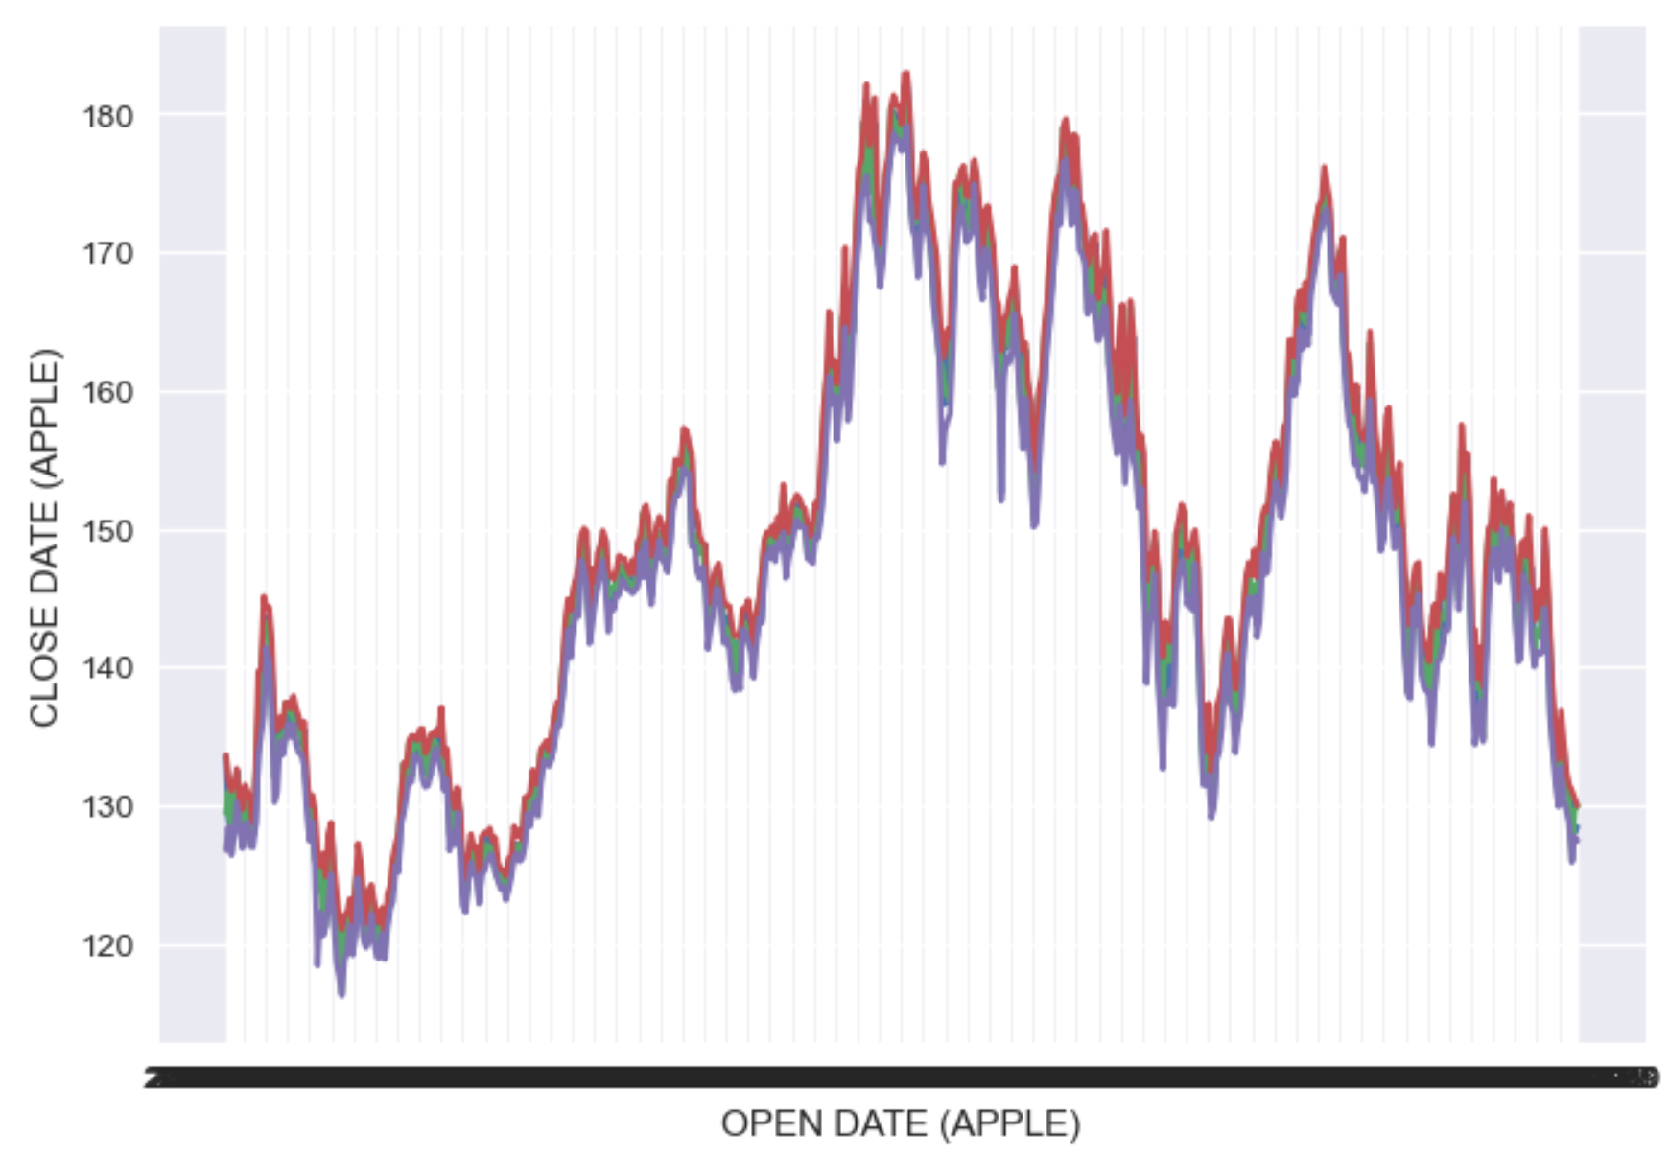
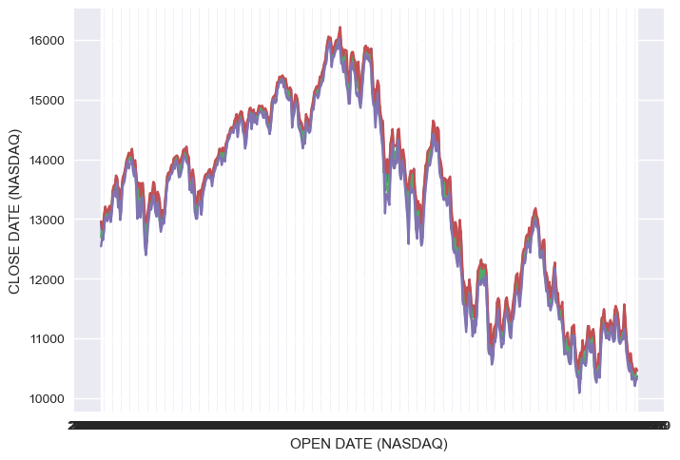
TECH STOCK ANALYSIS
Trend
Medium Exception
NASDAQ
Prices anlyzed show a negative tendency with a price reduction
Tech stocks fell more than 30% in 2022
Possible causes: higher interest rates, high inflation and uncertain economic conditions
Apple followed another type of tendency with more ups and downs compared to the rest of companies analyzed
Apple stocks fell 27% in 2022
NASDAQ, was down over a 33% during the year 2022 following the trend of the rest of companies.
NASDAQ components are mainly tech companies

Slide 5


RECOMMENDATIONS
Predictions
Portfolio Strategy recommendation
Predictions are not showing a better outlook on the tech price stocks
The world context is not showing any changes in the recent months: still high inflation and economic uncertainty
AI investment and recent layoffs could make it better for tech companies → More credibility for shareholders
It is time to buy tech stocks due the low prices
It is not time to sell tech stocks in the short term. Wait until predictions are better in the long term
Apple stocks seem to be more stable due the increase of sales during 2022. Also, Apple has been one of the companies that didn’t perform any layoff → Apple stocks will suit better for a conservative client

